Slide 1
TCP Congestion Control
CSE 118: Computer Networks
George Varghese
(some slides by Alex Snoeren)

Slide 2
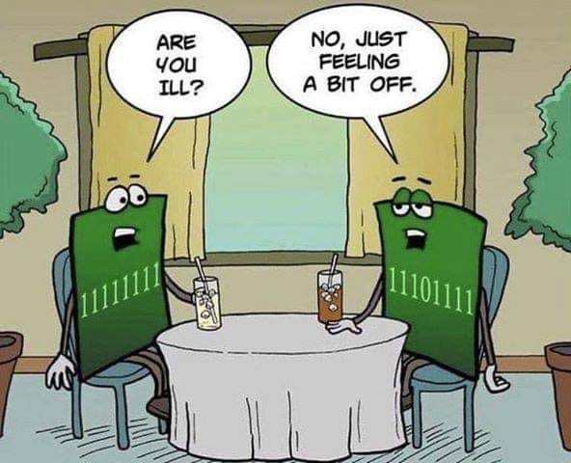

Slide 3

Flow vs Congestion Control
Receiver
Sender
Network
Flow Control: Matching speed of sender to receiver speed
Congestion Control: Matching speed of sender to network speed

Slide 4
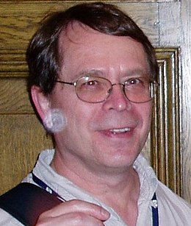
He saved the Internet (1980s)

Slide 5
FLOW CONTROL
Windows provide static flow control. Can provide dynamic flow control if receiver acks indicate Lower and Upper Window Edge.
D(0)
D(1)
Normally would slide to 1,3 but receiver reduces window to 2
1,2
A(1,2)
D(2)
Need to avoid deadlock if window is reduced to 0 and then increase to c > 0. In OSI, receiver keeps sending c. In
TCP, sender periodically probes an empty window.

Slide 6
WHY CONGESTION CONTROL IS NEEDED
Upgrade to 1 M
S
D
19.2 M
19.2
19.2
WHEN LINK FROM S TO FIRST ROUTER WAS UPGRADED FROM
19.2 KBPS TO 1 MBPS, THE TIME FOR A FILE TRANSFER WENT
UP FROM A FEW SECONDS TO A FEW HOURS
2) THIS HAPPENED IN AN EXPERIMENT IN DEC IN THE 1980s.
SHOWED THE NEED FOR CONGESTION CONTROL (DECBIT)
VERY SIMILAR EXPERIENCES IN INTERNET LED VAN JACOBSON
TO PROPOSE TCP CONGESTION CONTOL. VAN IS AN AFFILIATE
PROFESSOR AT UCLA!

Slide 7
Congestion Control Overview
How fast should a sending host transmit data?
Not too fast, not to slow, just right…
Should not be faster than the sender’s share
Bandwidth allocation
Should not be faster than the network can process
Congestion control
Congestion control & bandwidth allocation are separate ideas, but frequently combined

Slide 8
Fair Bandwidth Allocation
How much bandwidth should each flow from a source to a destination receive when they compete for resources?
What is a “fair” allocation?
Source
100Mbps
1
Router
Destination
10Mbps
1
4Mbps
Source
10Mbps
Router
2
Router
6Mbps
10Mbps
Destination
2
Source
3

Slide 9
Congestion
Buffer intended to absorb bursts when input rate > output
But if sending rate is persistently > drain rate, queue builds
Dropped packets represent wasted work; goodput < throughput
Source
1
10-Mbps Ethernet
Router
Destination
1.5-Mbps T1 link
100-Mbps FDDI
Source
2
Packets dropped here

Slide 10
Uncontrolled congestion?
Loss due to
Congestion
Throughput
Latency
Congestion
collapse
Network Load

Slide 11
WHY CONGESTION COLLAPSE CAN OCCUR
A
B
C D
All packets go one hop and get dropped because of congestion
So no packets make progress. Goodput goes to 0,
Like gridlock in LA but more like livelock here.

Slide 12
Congestion Collapse
Rough definition: “When an increase in network load produces a decrease in useful work”
Why does it happen?
Sender sends faster than bottleneck link speed
Packets queue until dropped
In response to packets being dropped, sender retransmits
All hosts repeat in steady state…

Slide 13
Mitigation Options
Increase network resources
More buffers for queuing
Increase link speed
Pros/Cons of these approaches?
Reduce network load (TCP strategy)
Send data more slowly
How much more slowly?
When to slow down?

Slide 14
Designing a Control Scheme
Open loop
Explicitly reserve bandwidth in the network in advance
Closed loop (TCP Strategy)
Respond to feedback and adjust bandwidth allocation
Network-based
Network implements and enforces bandwidth allocation
Host-based (TCP Strategy)
Hosts are responsible for controlling their sending rate

Slide 15
FEEDBACK CONGESTION CONTROL
New source
S
D
1 M
19.2
19.2
DETECT CONGESTION
FEEDBACK INFORMATION TO THE SOURCE
SOURCE ADJUSTS WINDOW: INCREASE POLICY DECREASE POLICY
TWO INTERESTING CASES:
HOW A SOURCE REACHES STEADY STATE.
HOW A SOURCE REACTS TO A NEW SOURCE TO PROVIDE A FAIR ALLOCATION.
CONGESTION AVOIDANCE VERSUS CONGESTION CONTROL

Slide 16
Proactive vs. Reactive
Congestion avoidance: try to stay to the left of the knee
Congestion control: try to stay to the left of the cliff
Loss due to
Congestion
“Cliff”
“Knee”
Throughput
Latency
Congestion
collapse
Network Load

Slide 17
Detecting Congestion
Explicit congestion signaling
Source Quench: ICMP message from router to sender
DECBit / Explicit Congestion Notification (ECN):
Router marks packet based on queue occupancy (i.e. indication that packet encountered congestion along the way)
Receiver tells sender if queues are getting too full
Implicit congestion signaling
Packet loss
Assume congestion is primary source of packet loss
Lost packets indicate congestion
Packet delay
Round-trip time increases as packets queue
Packet inter-arrival time is a function of bottleneck link

Slide 18
Throttling Options
Window-based (TCP)
Constrain number of outstanding packets allowed in network
Increase window to send faster; decrease to send slower
Pro: Cheap to implement, good failure properties
Con: Creates traffic bursts (requires bigger buffers)
Rate-based (many streaming media protocols)
Two parameters (period, packets)
Allow sending of x packets in period y
Pro: smooth traffic
Con: fine-grained per-connection timers, what if receiver fails?

Slide 19
Choosing a Send Rate
Ideally: Keep equilibrium at “knee” of power curve
Find “knee” somehow
Keep number of packets “in flight” the same
Don’t send a new packet into the network until you know one has left (I.e. by receiving an ACK)
What if you guess wrong, or if bandwidth availability changes?
Compromise: adaptive approximation
If congestion signaled, reduce sending rate by x
If data delivered successfully, increase sending rate by y
How to relate x and y? Most choices don’t converge…

Slide 20
TCP’s Probing Approach
Each source independently probes the network to determine how much bandwidth is available
Changes over time, since everyone does this
Assume that packet loss implies congestion
Since errors are rare; also, requires no support from routers
Source
Router
Sink
100 Mbps Ethernet
45 Mbps T3 link

Slide 21
Basic TCP Algorithm
Window-based congestion control
Unified congestion control and flow control mechanism
rwin: advertised flow control window from receiver
cwnd: congestion control window
Estimate of how much outstanding data network can deliver in a round-trip time
Sender can only send MIN(rwin,cwnd) at any time
Idea: decrease cwnd when congestion is encountered; increase cwnd otherwise
Question: how much to adjust?

Slide 22
Congestion Avoidance
Goal: Adapt to changes in available bandwidth
Additive Increase, Multiplicative Decrease (AIMD)
Increase sending rate by a constant (e.g. MSS)
Decrease sending rate by a linear factor (e.g. divide by 2)
Rough intuition for why multiplicative is good
One source reaches steady state window of 24
New source comes up and starts with window of 1
When both increase and detect congestion, first source cuts to 12 and other to 1. Eventually they equalize. Fairness!

Slide 23
TCP Bandwidth Probing
TCP uses AIMD to adjust congestion window
Converges to fair share of bottleneck link
Increases modestly in good times
Cuts drastically in bad times
But what rate should a TCP flow use initially?
Need some initial congestion window
We’d like to TCP to work on all manner of links
Need to span 6+ orders of magnitude, e.g., 10 K to 10 Gbps.
Starting too fast is catastrophic! So start with cwnd = 1

Slide 24
Slow Start
Goal: quickly find the equilibrium sending rate
Quickly increase sending rate until congestion detected
Remember last rate that worked and don’t overshoot it
TCP Reno Algorithm:
On new connection, or after timeout, set cwnd=1 MSS
For each segment acknowledged, increment cwnd by 1 MSS
If timeout then divide cwnd by 2, and set ssthresh = cwnd
If cwnd >= ssthresh then exit slow start
Why called slow? Its exponential after all…

Slide 25
TCP CONGESTION CONTROL SUMMARY
S
D
10
1
Linear
Fast Retransmit
threshold
Timeout
Window
(cwnd)
Slow Start
Time

Slide 26
Slow Start Example
Sender
Receiver
1
cwnd=1
Ack 2
2
cwnd=2
3
Ack 3
Ack 4
4
cwnd=4
5
Ack 5
6
Ack 6
7
Ack 7
Ack 8
cwnd=8

Slide 27
Basic Mechanisms
Timeout
Congestion
avoidance
ssthresh
Slow start

Slide 28
Fast Retransmit & Recovery
Fast retransmit
Timeouts are slow (default often 200 ms or 1 second)
When packet is lost, receiver still ACKs last in-order packet
Use 3 duplicate ACKs to indicate a loss; detect losses quickly
Why 3? When wouldn’t this work?
Fast recovery
Goal: avoid stalling after loss
If there are still ACKs coming in, then no need for slow start
If a packet has made it through -> we can send another one
Divide cwnd by 2 after fast retransmit
Increment cwnd by 1 MSS for each additional duplicate ACK

Slide 29
Fast Retransmit Example
Sender
Receiver
1
Ack 2
2
3
Ack 3
Ack 4
4
3 Dup
Acks
5
Ack 4
6
Ack 4
7
Ack 4
8
Ack 4
4
Fast recovery
(increase cwnd by 1)
Fast
retransmit

Slide 30
More Sophistication
Fast recovery

Slide 31
Short Connections
Short connection: only contains a few pkts
How do short connections and Slow-Start interact?
What happens when a packet is lost during Slow-Start?
What happens when the SYN is dropped?
Bottom line: Which packet gets dropped matters a lot
SYN
Slow-Start
Congestion avoidance
Do you think most flows are short or long?
Do you think most traffic is in short flows or long flows?

Slide 32
Open Issues
TCP is designed around the premise of cooperation
What happens to TCP if it competes with a UDP flow?
What if we divide cwnd by 3 instead of 2 after a loss?
There are a bunch of magic numbers
Decrease by 2x, increase by 1/cwnd, 3 duplicate acks, initial timeout = 3 seconds, etc.
But overall it works really well!
Still being constantly tweaked…

Slide 33
TCP CC Summary
TCP Probes the network for bandwidth, assuming that loss signals congestion
The congestion window is managed with an additive increase/multiplicative decrease policy
It took fast retransmit and fast recovery to get there
Fast recovery keeps pipe “full” while recovering from a loss
Slow start is used to avoid lengthy initial delays
Ramp up to near target rate, then switch to AIMD

Slide 34
TCP CONGESTION CONTROL SUMMARY
S
D
10
1
Linear
Fast Retransmit
threshold
Timeout
Window
(cwnd)
Slow Start
Time

Slide 35
TCP + Router Scheduling
So far we’ve done flow-based traffic policing
Limit the rate of one flow regardless of the load in the network
In general, need scheduling at routers as well!
Dynamically allocate resources when multiple flows compete
Give each “flow” (or traffic class) own queue (at least theoretically)
Weighted fair queuing
Schedule round-robins among queues in proportion to some weight parameter. Deficit Round Robin

Slide 36
Why we need router scheduling
1 UDP (10 Mbps) and 31 TCPs sharing a 10 Mbps line
UDP (#1) - 10 Mbps
UDP (#1)
TCP (#2)
TCP (#2)
.
.
.
.
.
.
TCP (#32)
TCP (#32)
Bottleneck link
(10 Mbps)

Slide 37
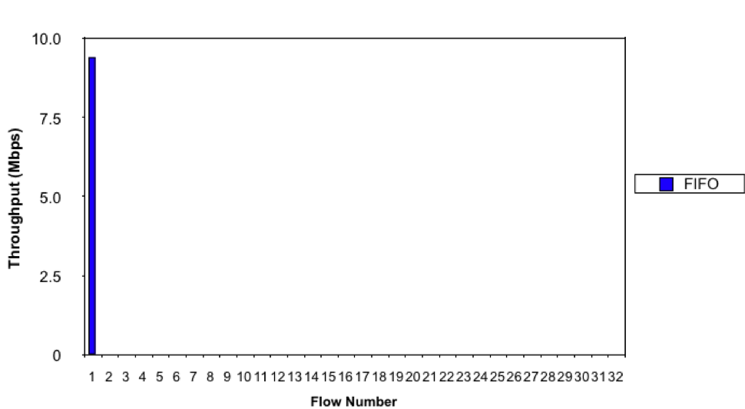
UDP vs. TCP w/FIFO

Slide 38
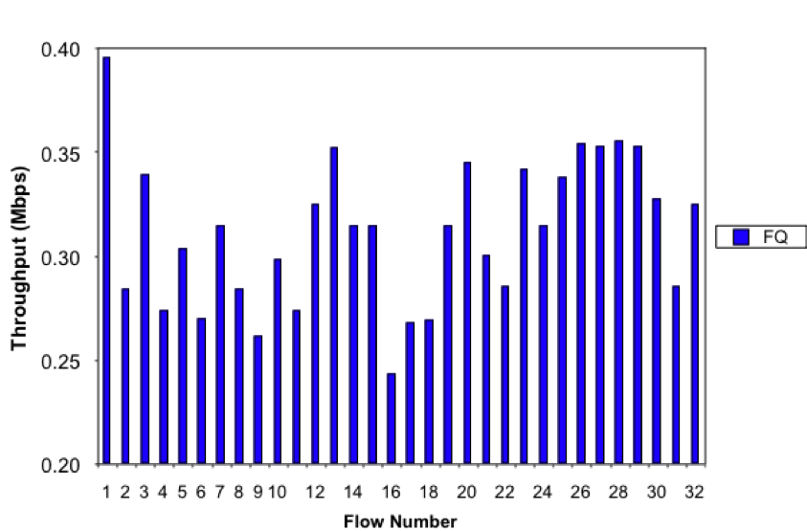
TCP vs. UDP w/Fair Queuing

Slide 39
(Weighted) Fair Queuing
Flow 1
Flow 2
I/P
O/P
Deficit Round Robin is
Often used. Shreedhar
And Varghese
Flow n

Slide 40
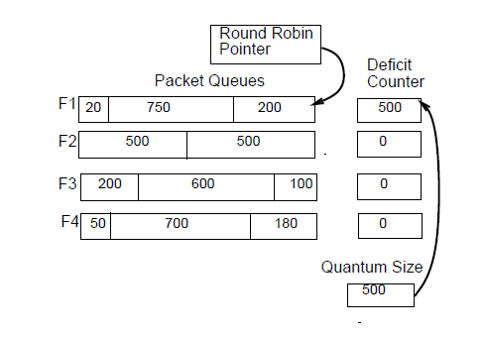
How DRR works

Slide 41
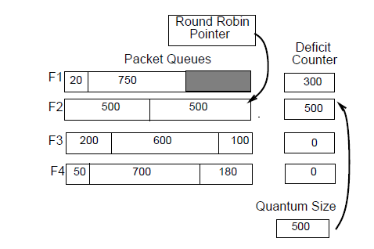
After sending packet

Slide 42
WHY ROUTERS ALSO DO RANDOM EARLY DETECT
10
1
D
S
DECbit/ECN sets a congestion bit
RED randomly drops a packet
Q: Why would a router drop a perfectly good packet even if has buffer space
A: As an early form of congestion warning if one does not have a congestion bit. Many IP routers have such a bit today, called the ECN bit

Slide 43
Some new ideas
HTTP Pipelining: To reduce latency browser opens up multiple connections. Still slow over TCP.
QUIC: Layered below HTTP and above TCP, places multiple streams in a single connection. Finesses slow start. Loss on one stream does not interrupt other stream. Avoids extra handshakes for TLS
TCP fluctuates too much. New protocols like DCTCP adjust more smoothly in Microsoft Data Centers. Also used by Apple

Slide 44
Lecture Summary
Unlike a reliable data link we also need to match speed of sender to receiver AND the whole network
TCP increases and decreases its window using Slow Start + AIMD, decreasing on loss or ECN
Needs to be accompanied by router scheduling mechanisms like DRR and RED/ECN setting
TCP fluctuates too much. New protocols like DCTCP adjust more smoothly in Microsoft DCs.

